Slide 1
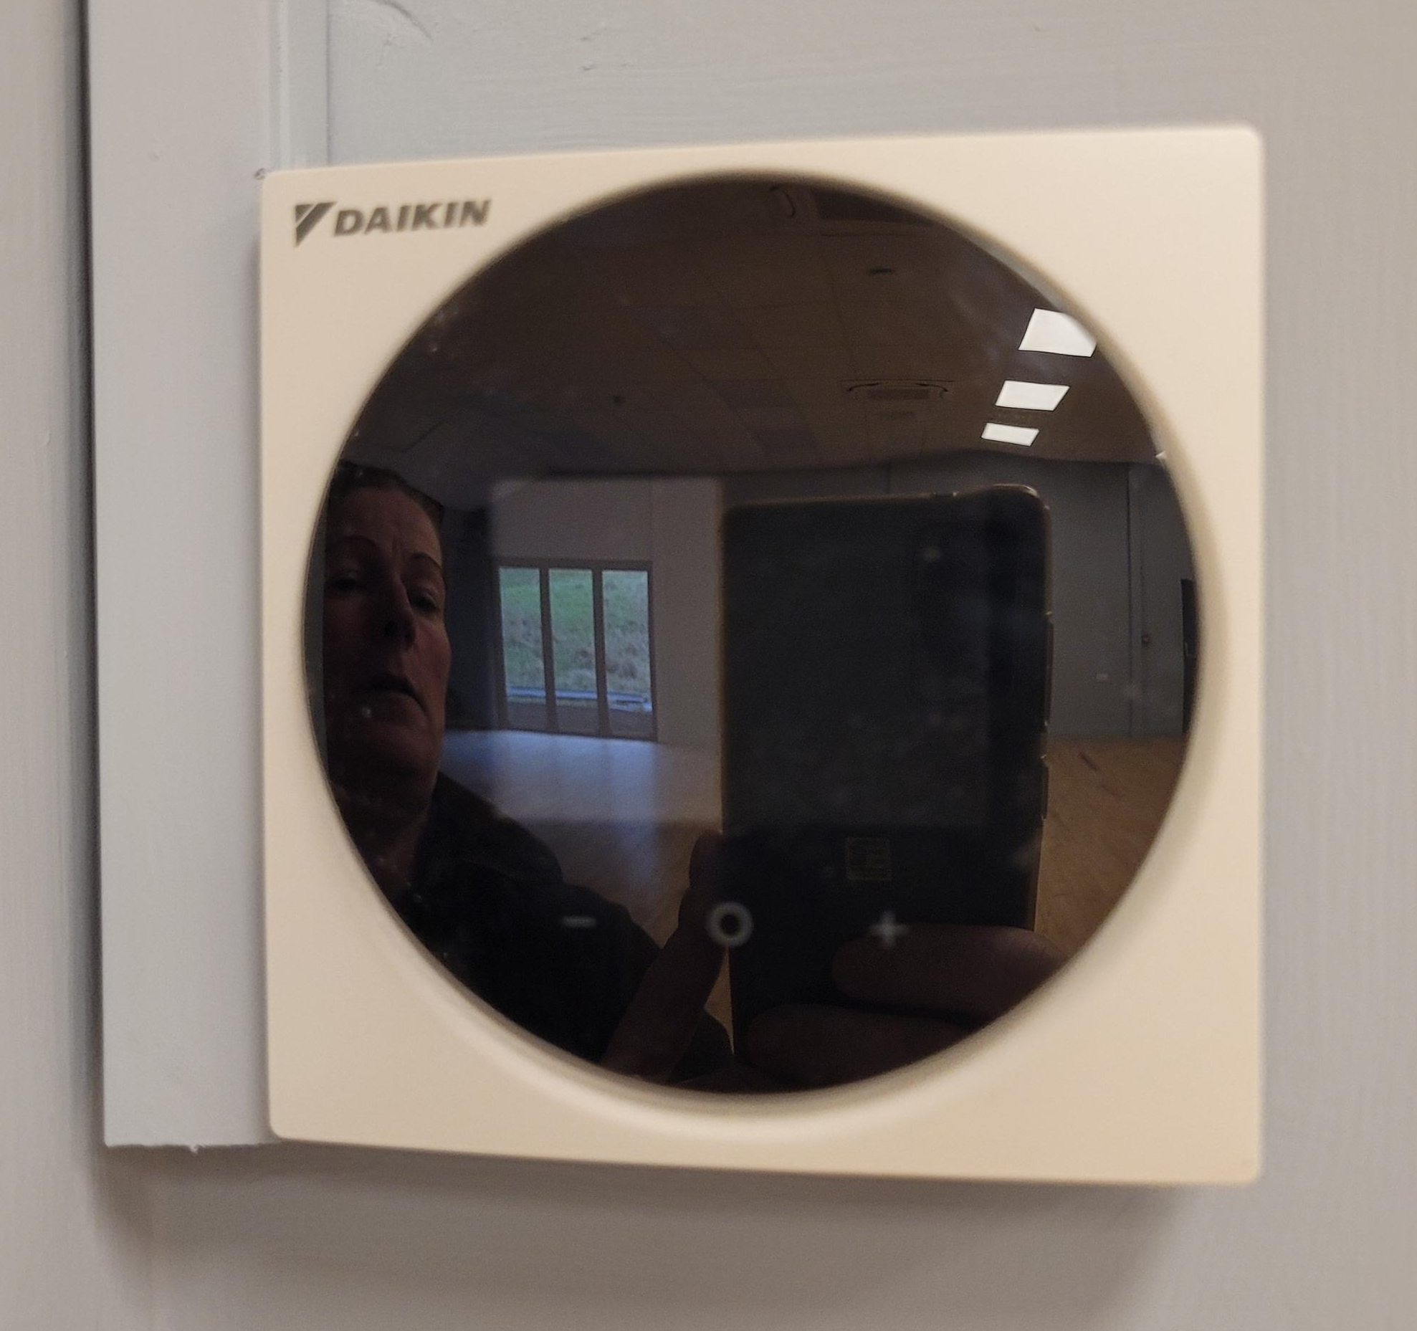
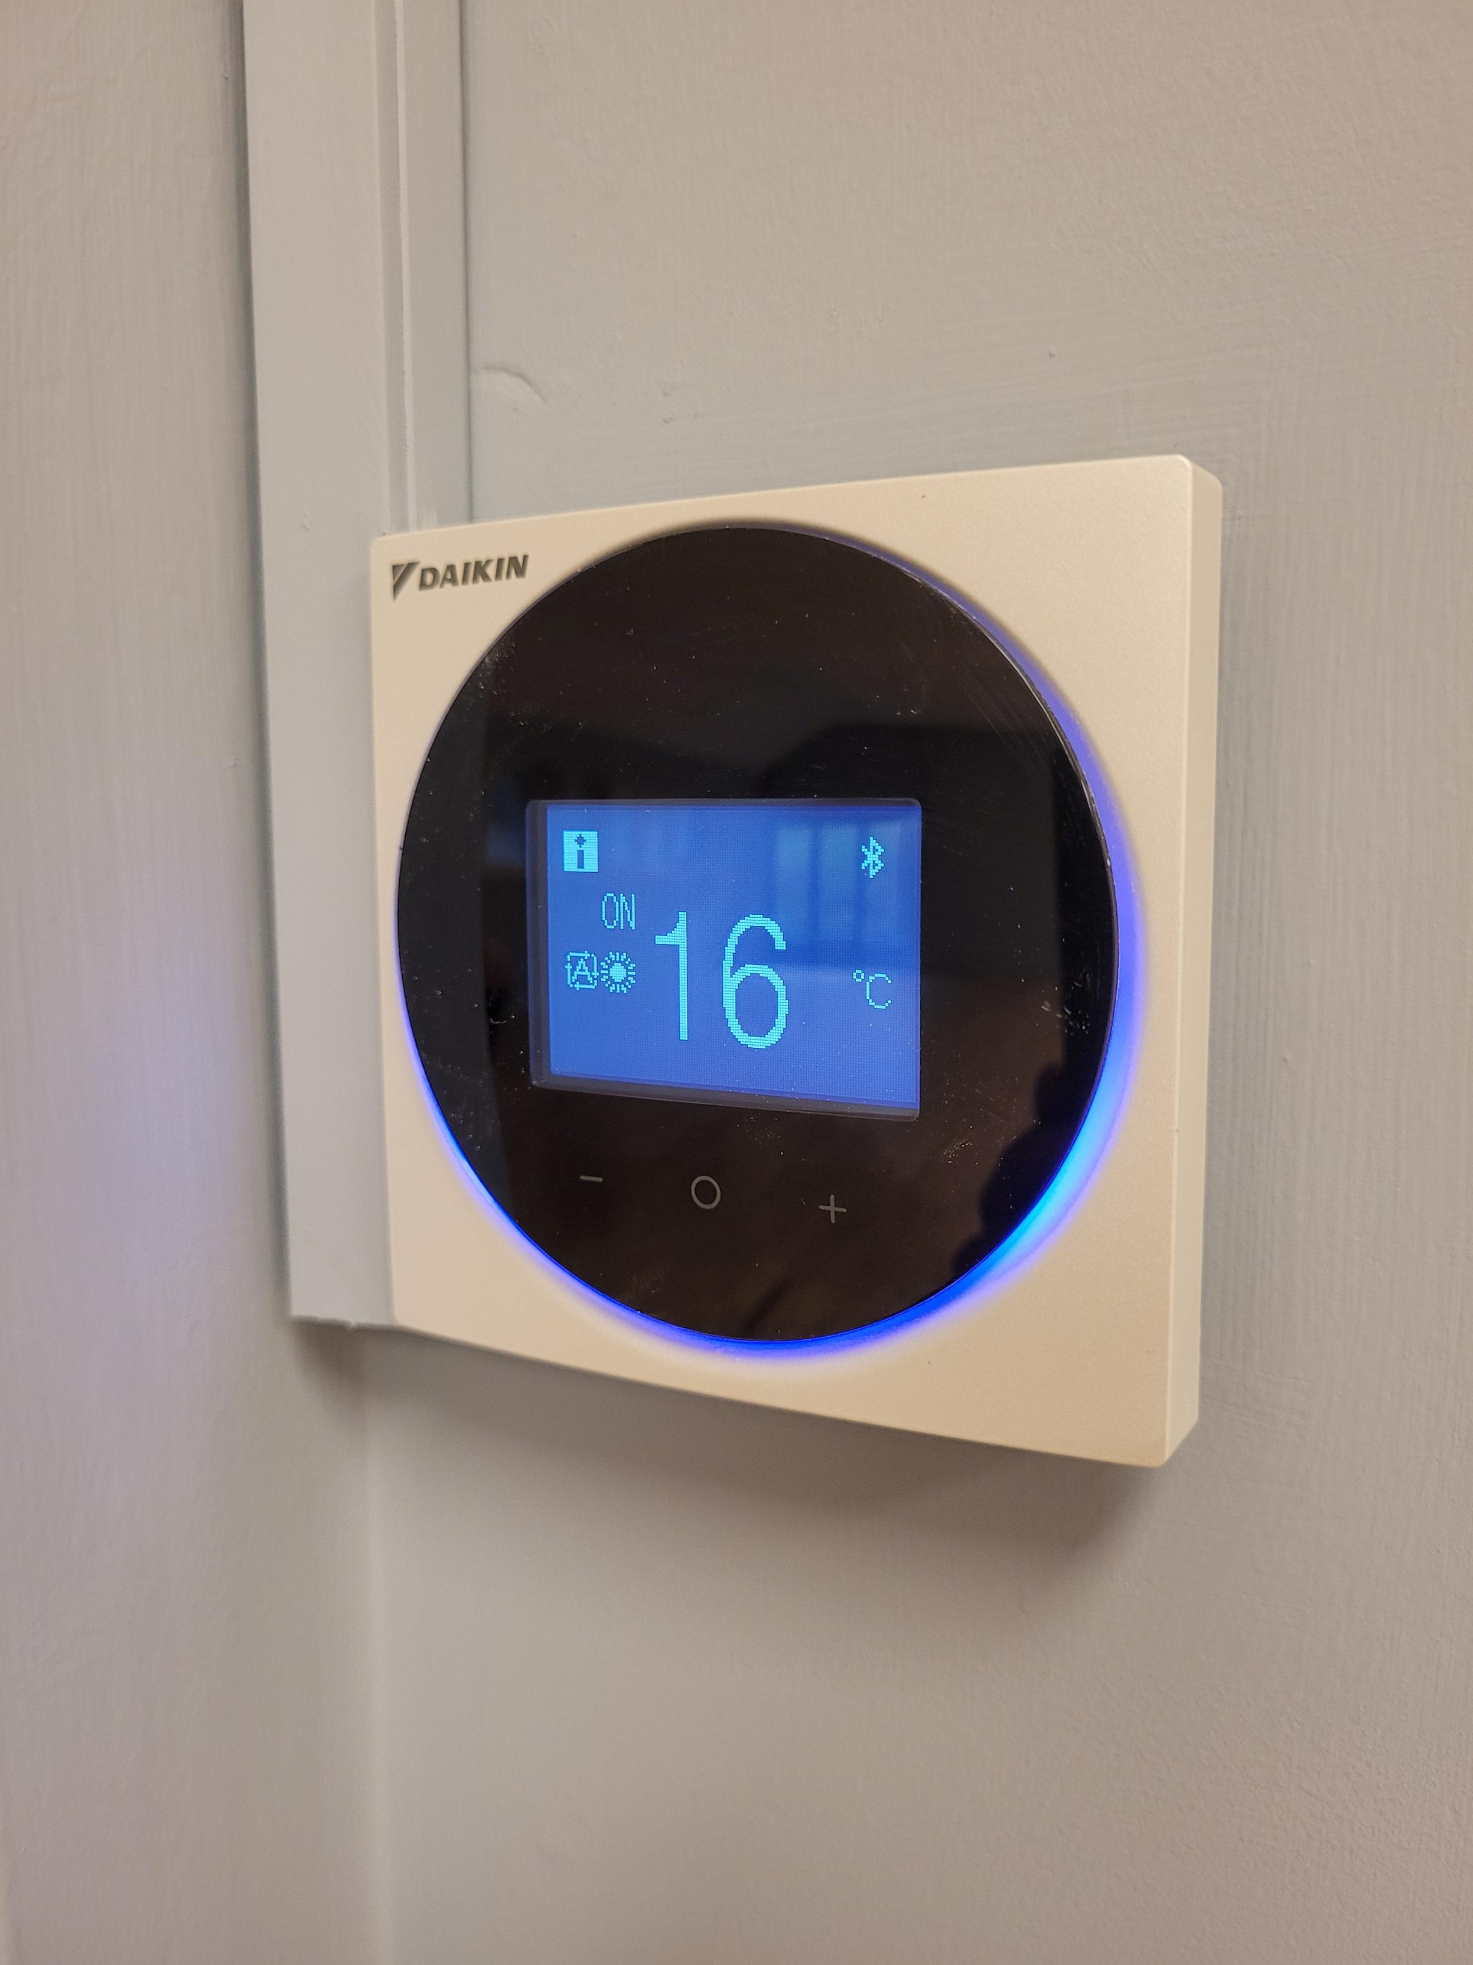
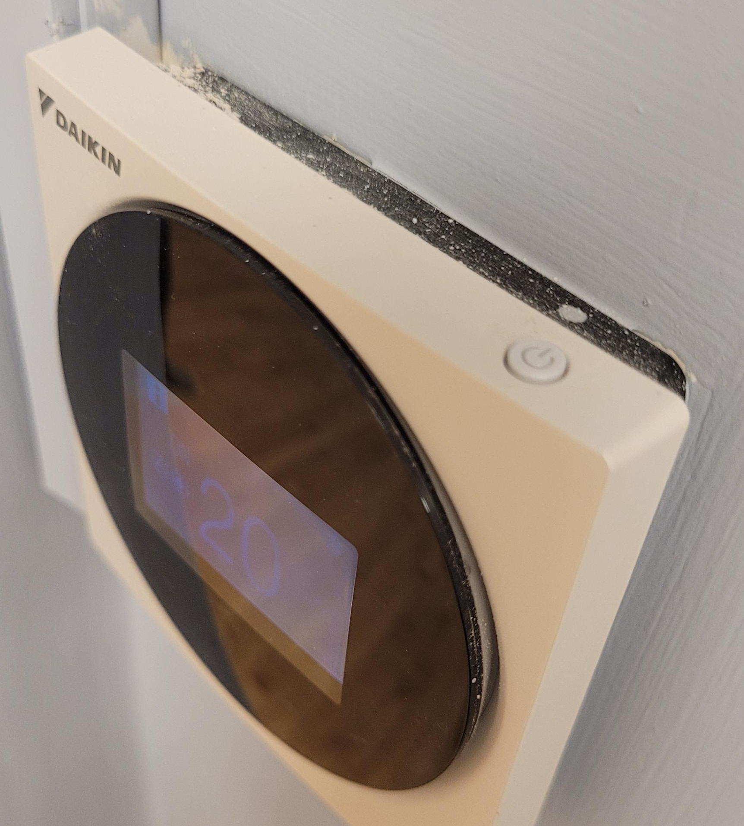
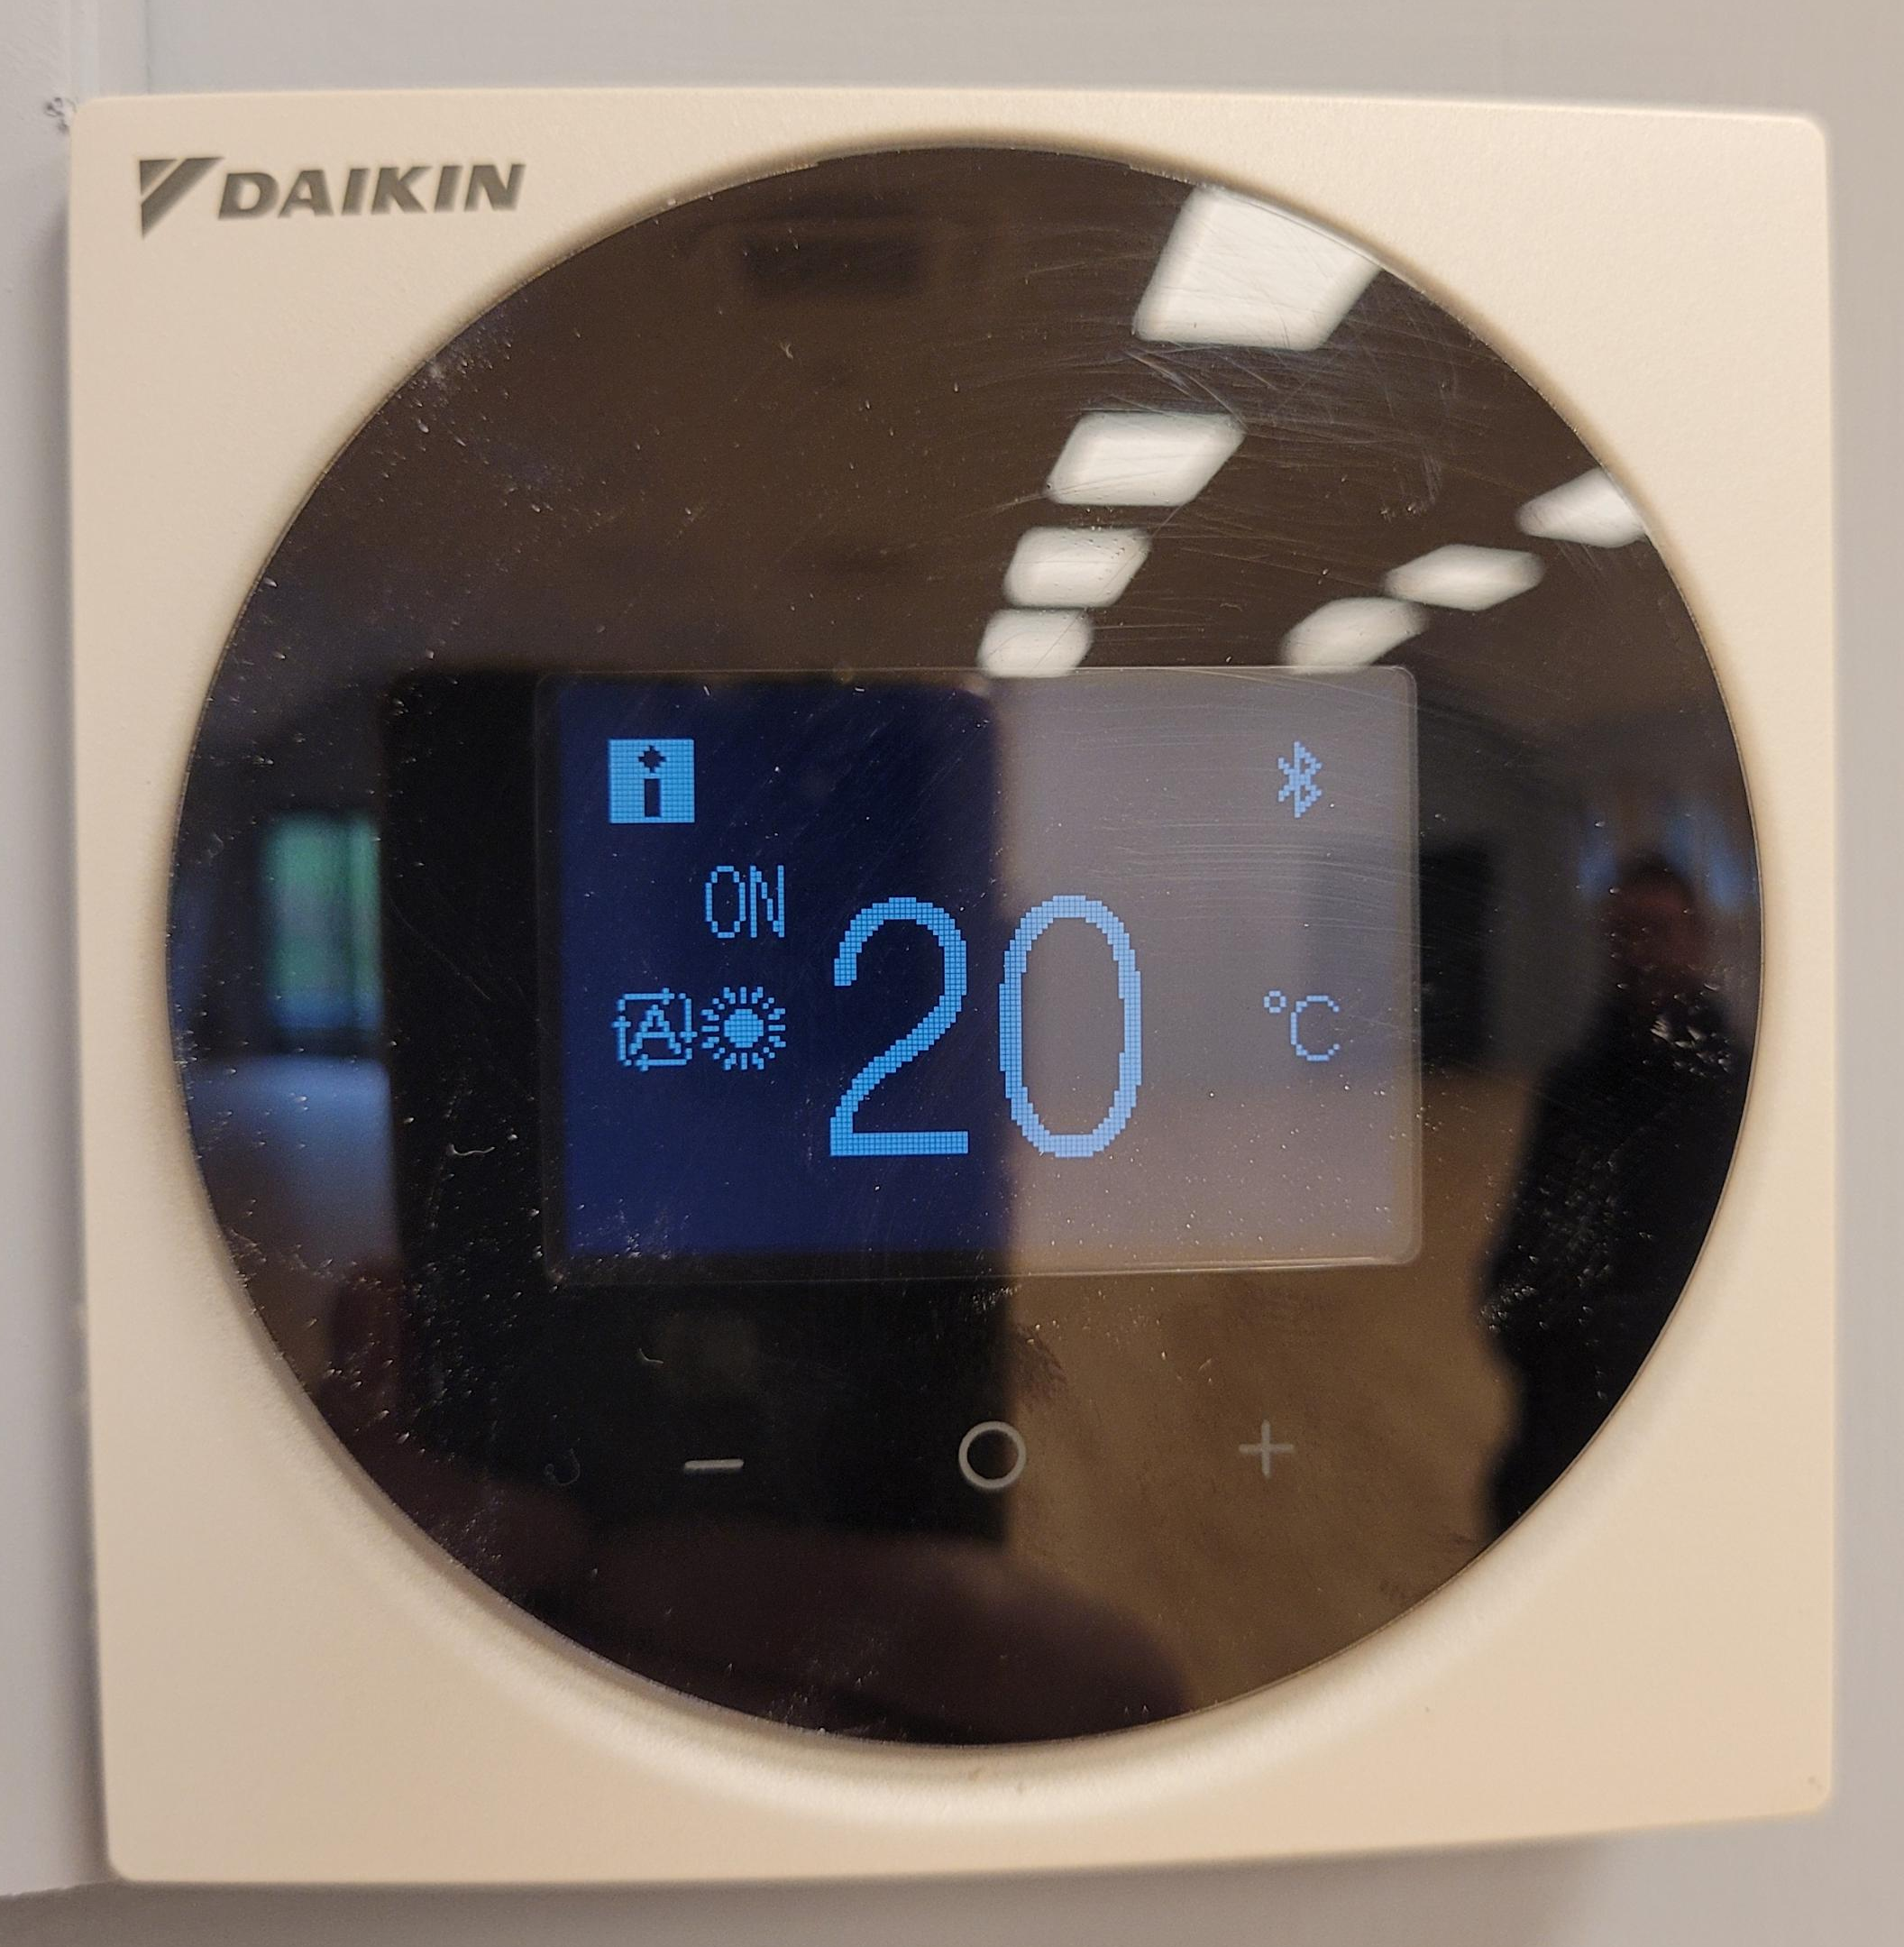
1.
2.
The unit screen will appear black/blank when you first look at it.
Tap the plus or minus button [ - + ]
near the bottom of the black circle to activate the screen.
When the unit lights up you will be able to tell if the heating/cooling is ON or OFF.
You will also see the current temperature setting.
OFF
- +
3.
4.
With ON displaying, press the – or + buttons to the cooling or temperature you desire.
The settings will be retained for 2 hours. If you want further heat or cooling after 2 hours repeat this procedure.
When your hire is finished, please turn the heating OFF.
If the heating/cooling is off, press the on/off button on the top right corner of the unit .
Press the same button to turn the heating/cooling off at any point.
ON

